Slide 1


Deep Learning Bild & Signal (DLBS)
Mini-challenge : Object detection / Instance segmentation for detecting Strawberry disease
Bruno Kreiner & Navjot Zubler

Slide 2
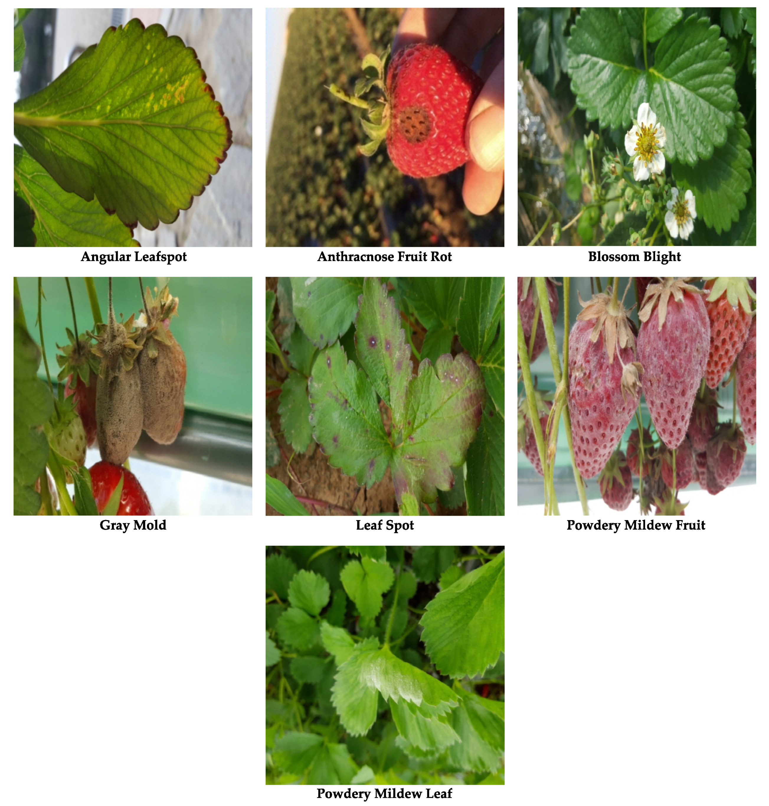
Milestone 1 – DLBS Mini-challenge Pitch: Data, Research question, Methods
Data:
Research question:
Strawberry disease images in JPG format ~2500
Available as ‘train’, ‘val’ & ‘test’ split
Per image one json file with one of the seven strawberry diseases & polygon points
How effectively can the adaptation of a deep learning architectures improve the instance segmentation / object detection performance for the identification of strawberry diseases when compared to the baseline Mask R-CNN model?
Referencing paper https://paperswithcode.com/task/instance-segmentation for selecting another model to compare against
Methods:
Mask R-CNN as base model
YOLO
Demo on 16.05.2023:
Request to present as first group at 14:15 since Bruno has P6 Interim presentation at 16:00
Source: Kaggle

Slide 3
Milestone 1 – DLBS Mini-challenge Additional Evaluation criteria
MC organisation in Sprint format Mini-challenge is organized and structured in sprint format with weekly sprint goals, sprint review to reflect on the progress, next steps & risks/improvements | 6. Sprint planning done with backlog/scope for each week with clear sprint goals to be achieved. All 5 sprint goals achieved on time. Sprint review & retrospective was conducted, documented and shared every week with Susanne. 5. Sprint planning done with goals per sprint. 1 out of 5 sprint goals missed. Sprint review per week conducted, documented and shared with every week. 4. High level sprint planning in place. 60% of sprint goals were achieved on time i.e. 2 out of 5 sprint goal missed. Sprint review conducted, documented and shared with final submission. 3. High level sprint planning in place. 4 out of 5 sprint goals missed. No weekly tracking & progress documented. 2. High level sprint planning in place. All sprint goals missed. No weekly tracking 1. No high level sprint planned.

Slide 4
DLBS Mini-challenge Backlog 18.04.2023 – 19.05.2023
Deep-dive 3 participation​
Data inspection​ (Step 1) and summary
Setup GitHub​
Pitch prep and presentation on 25.04​ (Milestone 1)
Weekly review & retrospective documentation
Set up Training skeleton with Baseline model in place ​(Step 2)
Overfit model (Step 3)
Regularize model (Step 3)
Model tuning (Step 4)
Mini-Challenge report documentation (Overleaf)
Prep and present Demo on 16.05.2023 (Milestone 2)
My DLBS Learn-Diary (Bonus task)
Final submission – GitHub on 19.05.2023 (Milestone 3)

Slide 5
DLBS Sprint goals 18.04.2023 – 19.05.2023
Sprint | sprint goals
Week 18.04. – 21.04.2023 | Deep-dive 3 participation Step 1: Data inspection Setup GitHub Milestone 1 : Pitch on 25.04 Weekly review & retrospective conducted & documented
week 24.04. – 28.04.2023 | Step 2: Training skeleton with Baseline model in place Weekly review & retrospective
week 01.05. – 05.05.2023 | Step 3: Overfit and regularize per person Weekly review & retrospective conducted & documented
week 08.05 – 12.05.2023 | step 4: Model tuning Weekly review & retrospective conducted & documented
week 15.04. – 19.05.2023 | Documentation completed Milestone 2: Demo on 16.05.2023 Weekly review & retrospective conducted & documented Bonus task per person Milestone 3: Final submission on 19.05.2023

Slide 6
Hypothesis
Hypothesis:
Two-stage object detection using Mask R-CNN may lead to significant improvements in model performance for detecting strawberry disease.
in instance segmentation performance for detecting strawberry diseases, potentially outperforming the baseline Mask R-CNN model
To be updated

